Slide 1

Machine Learning
Regularization
Pramote Kuacharoen

Slide 2



Linear Regression Overfitting
If we have too many features, the learned hypothesis may fit the training set very well, but fails to generalize to new data
y
y
y
x
x
x
$$θ_{0}+θ_{1}x$$
$$θ_{0}+θ_{1}x+θ_{2}x^{2}$$
$θ_{0}+θ_{1}x+θ_{2}x^{2}$+ $θ_{3}x^{3}$+ $θ_{4}x^{4}$
Underfit or High bias
Overfit or High Variance

Slide 3
Logistic Regression Overfitting
If we have too many features, the learned hypothesis may fit the training set very well, but fails to generalize to new data
x₂
x₂
x₂
x₁
x₁
x₁
Underfit or High bias
Overfit or High Variance

Slide 4

Mitigating Overfitting
Reduce number of features
Manually select which features to eliminate
Model selection algorithm
Regularization
Keep all features, but reduce magnitudes/values of parameters $θ_{j}$
Works well when we have many features, each of which contributes a little bit to predicting y

Slide 5


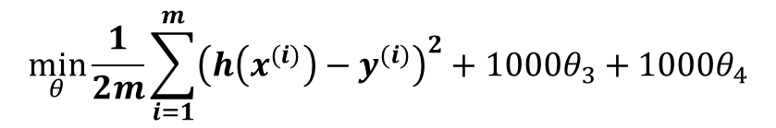
Intuition
y
y
x
x
$$θ_{0}+θ_{1}x+θ_{2}x^{2}$$
$θ_{0}+θ_{1}x+θ_{2}x^{2}$+ $θ_{3}x^{3}$+ $θ_{4}x^{4}$
Suppose we make $θ_{3}$ and $θ_{4}$ very small, the hypothesis is less influenced by the higher order terms
$$\min_{θ}{\frac{1}{2m}\sum_{i=1}^{m}{{\left(h\left(x^{(i)}\right)−y^{(i)}\right)}^{2}}}+1000θ_{3}+1000θ_{4}$$

Slide 6
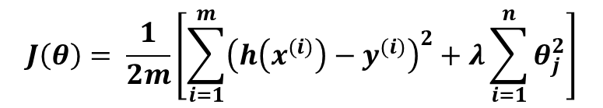


Regularization
Small values of parameters $θ_{0},θ_{1},{…, θ}_{n}$
Simpler hypothesis
Less prone to overfitting
$$J\left(θ\right)= \frac{1}{2m}\left[\sum_{i=1}^{m}{{\left(h\left(x^{(i)}\right)−y^{(i)}\right)}^{2}}+λ\sum_{i=1}^{n}{θ_{j}^{2}}\right]$$
$$\min_{θ}{J(θ)}$$

Slide 7
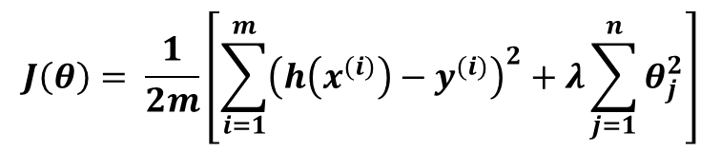
Regularized Linear Regression
What if λ is set to an extremely large value
Algorithm works fine
Algorithm fails to eliminate overfitting
Algorithm results in underfitting
Gradient descent fails to converge
$$J\left(θ\right)= \frac{1}{2m}\left[\sum_{i=1}^{m}{{\left(h\left(x^{(i)}\right)−y^{(i)}\right)}^{2}}+λ\sum_{j=1}^{n}{θ_{j}^{2}}\right]$$

Slide 8
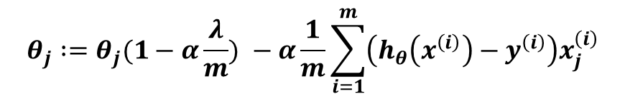
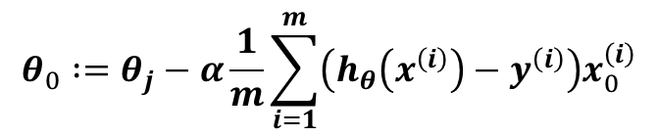
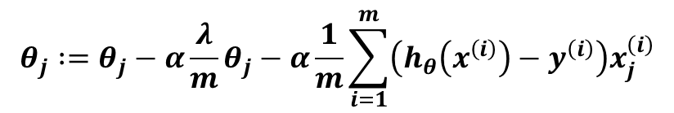
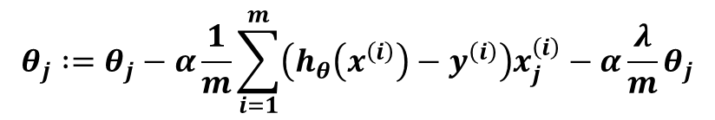
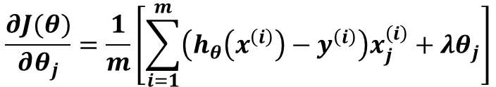
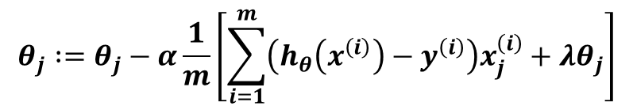
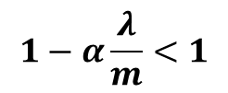
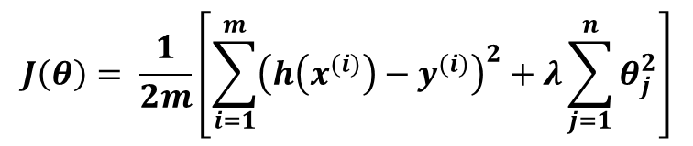
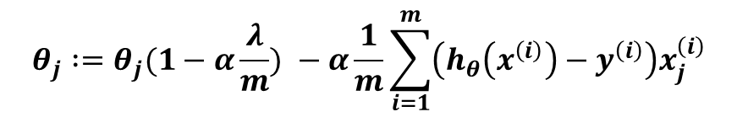
Gradient Descent
$$θ_{j} :=θ_{j}−α\frac{1}{m}\left[\sum_{i=1}^{m}{\left(h_{θ}\left(x^{\left(i\right)}\right)−y^{\left(i\right)}\right)x_{j}^{\left(i\right)}}+λθ_{j}\right]$$
$$J\left(θ\right)= \frac{1}{2m}\left[\sum_{i=1}^{m}{{\left(h\left(x^{(i)}\right)−y^{(i)}\right)}^{2}}+λ\sum_{j=1}^{n}{θ_{j}^{2}}\right]$$
$$θ_{j} :=θ_{j}−α\frac{1}{m}\sum_{i=1}^{m}{\left(h_{θ}\left(x^{\left(i\right)}\right)−y^{\left(i\right)}\right)x_{j}^{\left(i\right)}}−α\frac{λ}{m}θ_{j}$$
$$\frac{∂J(θ)}{∂θ_{j}}=\frac{1}{m}\left[\sum_{i=1}^{m}{\left(h_{θ}\left(x^{\left(i\right)}\right)−y^{\left(i\right)}\right)x_{j}^{\left(i\right)}}+λθ_{j}\right]$$
$$θ_{j} :=θ_{j}−α\frac{λ}{m}θ_{j}−α\frac{1}{m}\sum_{i=1}^{m}{\left(h_{θ}\left(x^{\left(i\right)}\right)−y^{\left(i\right)}\right)x_{j}^{\left(i\right)}}$$
$$θ_{j} :=θ_{j}(1−α\frac{λ}{m}) −α\frac{1}{m}\sum_{i=1}^{m}{\left(h_{θ}\left(x^{\left(i\right)}\right)−y^{\left(i\right)}\right)x_{j}^{\left(i\right)}}$$
Repeat:
$$θ_{0} :=θ_{j}−α\frac{1}{m}\sum_{i=1}^{m}{\left(h_{θ}\left(x^{\left(i\right)}\right)−y^{\left(i\right)}\right)x_{0}^{\left(i\right)}}$$
$$θ_{j} :=θ_{j}(1−α\frac{λ}{m}) −α\frac{1}{m}\sum_{i=1}^{m}{\left(h_{θ}\left(x^{\left(i\right)}\right)−y^{\left(i\right)}\right)x_{j}^{\left(i\right)}}$$
(j=1, 2, …, n)
$$1−α\frac{λ}{m}<1$$

Slide 9
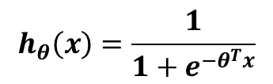
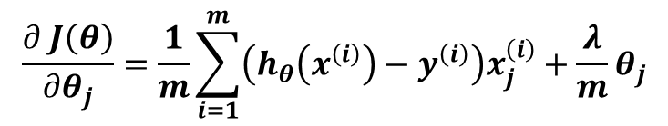
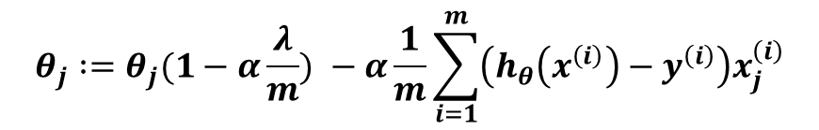
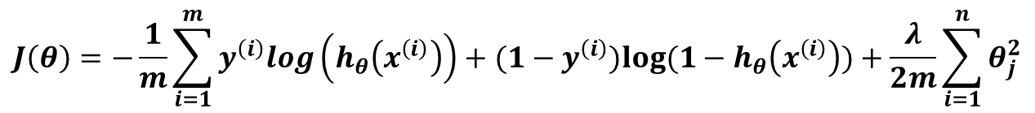
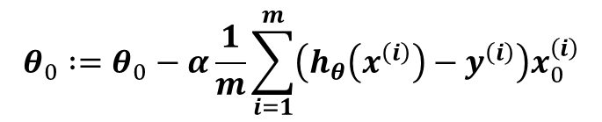
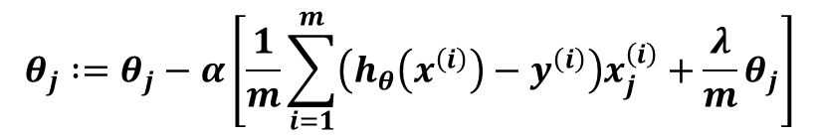
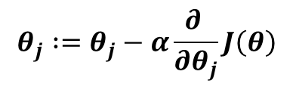
Regularized Logistic Regression
$$J\left(θ\right)=−\frac{1}{m}\sum_{i=1}^{m}{y^{\left(i\right)}log\left(h_{θ}\left(x^{\left(i\right)}\right)\right)+(1−y^{\left(i\right)})log⁡(1−h_{θ}\left(x^{\left(i\right)}\right))}+\frac{λ}{2m}\sum_{i=1}^{n}{θ_{j}^{2}}$$
$$h_{θ}\left(x\right)=\frac{1}{1+e^{−θ^{T}x}}$$
$$\frac{∂ J\left(θ\right)}{∂θ_{j}}=\frac{1}{m}\sum_{i=1}^{m}{\left(h_{θ}\left(x^{\left(i\right)}\right)−y^{\left(i\right)}\right)x_{j}^{\left(i\right)}}+\frac{λ}{m}θ_{j}$$
$$θ_{j} :=θ_{j}−α\frac{∂ }{∂θ_{j}}J\left(θ\right)$$
$$θ_{j} :=θ_{j}−α\left[\frac{1}{m}\sum_{i=1}^{m}{\left(h_{θ}\left(x^{\left(i\right)}\right)−y^{\left(i\right)}\right)x_{j}^{\left(i\right)}}+\frac{λ}{m}θ_{j}\right]$$
Repeat:
$$θ_{0} :=θ_{0}−α\frac{1}{m}\sum_{i=1}^{m}{\left(h_{θ}\left(x^{\left(i\right)}\right)−y^{\left(i\right)}\right)x_{0}^{\left(i\right)}}$$
$$θ_{j} :=θ_{j}(1−α\frac{λ}{m}) −α\frac{1}{m}\sum_{i=1}^{m}{\left(h_{θ}\left(x^{\left(i\right)}\right)−y^{\left(i\right)}\right)x_{j}^{\left(i\right)}}$$
(j=1, 2, …, n)

Slide 10
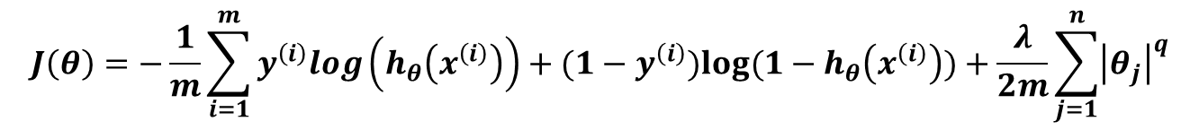
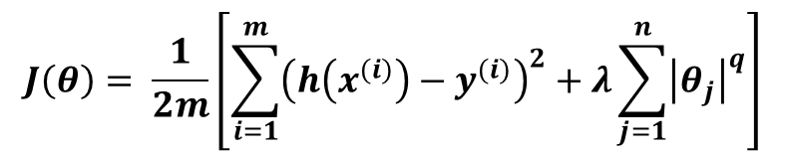
L1 vs L2 Regularization
$$J\left(θ\right)= \frac{1}{2m}\left[\sum_{i=1}^{m}{{\left(h\left(x^{(i)}\right)−y^{(i)}\right)}^{2}}+λ\sum_{j=1}^{n}{{\left|θ_{j}\right|}^{q}}\right]$$
Linear Regularization
$$J\left(θ\right)=−\frac{1}{m}\sum_{i=1}^{m}{y^{\left(i\right)}log\left(h_{θ}\left(x^{\left(i\right)}\right)\right)+(1−y^{\left(i\right)})log⁡(1−h_{θ}\left(x^{\left(i\right)}\right))}+\frac{λ}{2m}\sum_{j=1}^{n}{{\left|θ_{j}\right|}^{q}}$$
Logistic Regularization
L1 Regularization | L2 Regularization
Computational inefficient on non-sparse cases | Computational efficient due to having analytical solutions
Sparse outputs | Non-sparse outputs
Built-in feature selection | No feature selection

Slide 11
Question?
Insert Image

